Slide 1
Strategies for Processing Pending Matrix Changes
AZ Transfer
Notes:
Strategies for processing Pending Changes

Slide 2
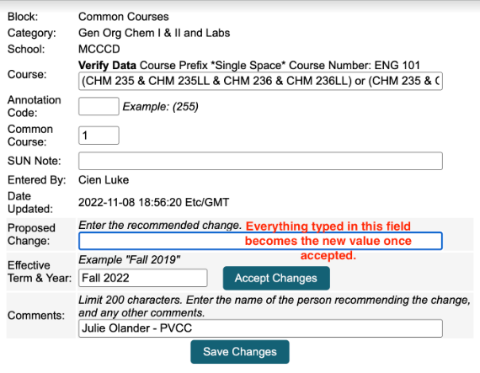
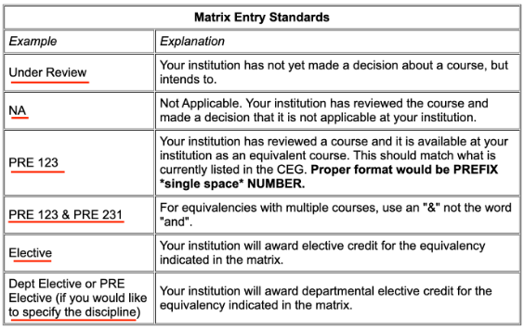

Proposed Change Entry
**Changes entered are proposals only until approval is received from the appropriate party at each college**

Slide 3
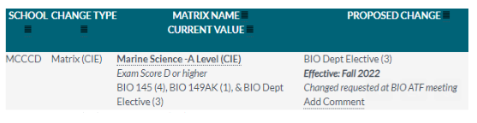
Processing Submitted Changes
Review Pending Matrix Changes in the Chatlines
Compare change requests to ATF Meeting notes
Email authorization request to appropriate Instructional Council (IC) Chair
Approve or deny change in the Chatlines based on IC Chair’s response

Slide 4
Processing Timeline
Review Matrix Change Requests at the start of each week once ATF meetings start
Send authorization request to IC chair
> if email is not responded to, send follow up email the in 1 week
>> if second email is not responded to, call the IC chair and/or department
Notes:
1 hour a week; include early “deadline” (before Feb 16) for response to encourage quick response
Most IC’s respond within 1 week or immediately following the 2nd email after confirming change with their IC

Slide 5
Questions from IC Chairs
Was the change request input correctly?
Who initiated the change request?
Does this change match our university partners?
Notes:
Confirm notes and change request match up, deny original request and input new request if needed
Provide ATF notes for member info

