Slide 1




AzTransfer facilitator training
June 5-6, 2023
Meeting Report strategies
Sherli Skinner

Slide 2
Questions to consider:
What seem to be the biggest obstacles to getting the Meeting Report submitted within 14 days of the meeting’s conclusion?
How do I mitigate those conditions?
Do I have a practice that makes recording meeting attendance easy?
How do I secure the notes from the notetaker in a timely manner?
How do I process the proposed changes before the Meeting Report is submitted?

Slide 3

Aztransfer atf meeting Checklist:
Welcome Email to all ATF members with information regarding the meeting and links to review prefixes and matrix
  Screen shot of RSVP attendees to verify actual attendance (or create your own attendance sheet for signatures)
Prepare ATF Meeting Agenda
  Ask ATF Members for Agenda Items
  Open digital documents and links from ATF Dashboards to make sure they work
Before the Meeting
During the Meeting
After the Meeting
Meeting Setup
Prepare & set-up 45-60 minutes prior to the meeting
  Make sure to log in and connect to Zoom
  Test connections and have proper files and web pages open
Take attendance
Ask for a notetaker
Ask for a volunteer to assist with monitoring the chat on Zoom
Log out of Zoom
Obtain the meeting notes from the notetaker (give your email address and/or take a screenshot of the notes)
Identify & record the name and institution of the host and chair for the next meeting
Confirm the date of the next meeting
Complete your meeting report & enter in proposed matrix changes
IMPORTANT: The complete meeting packet is due 14 days after the meeting. Strongly recommend to begin the report as soon as the meeting concludes.

Slide 4
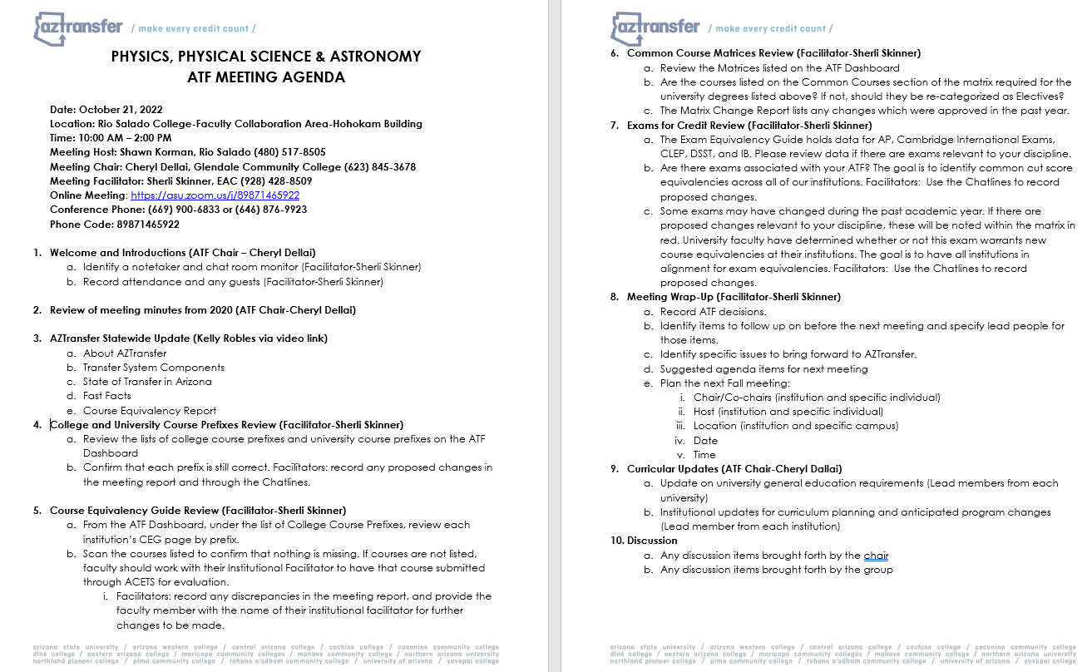
Before the meeting:
I send out an email to the Chair and Host of the ATF meeting to introduce myself and to get feedback for the agenda. Chair or myself will send out email to the ATF members to reply if there are any items they would like to see on the agenda.

Slide 5
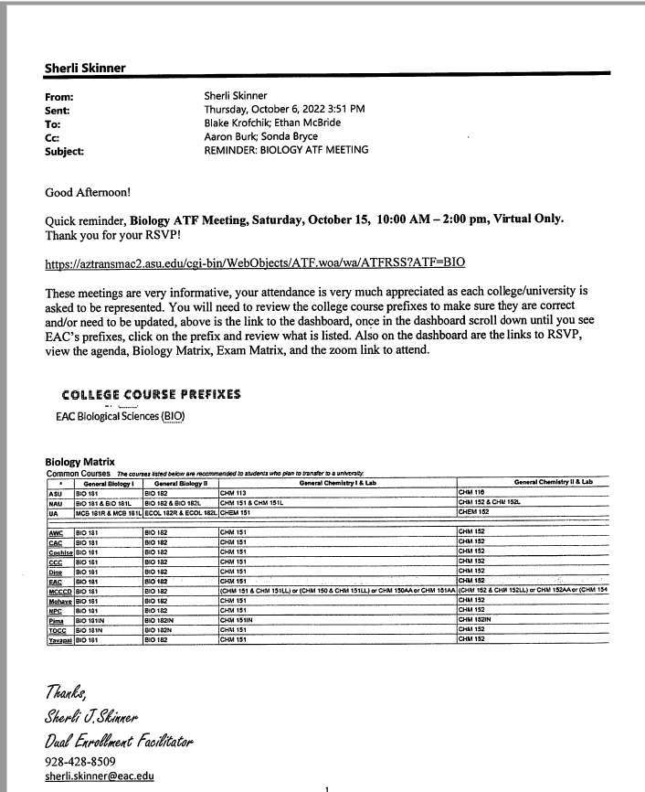
Side Note:
Because I’m the AzTransfer Facilitator at EAC, I know how important these ATF meetings are.
I send out reminder emails to the Lead members of each of the ATF Disciplines to review all the information that will be presented at the meeting, so when they are asked if there are any changes, they previously, have reviewed and discussed with their departments any changes that need to be reported to the matrix and/or prefixes.

Slide 6
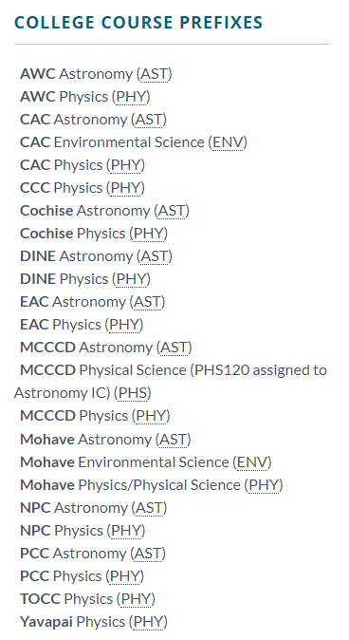
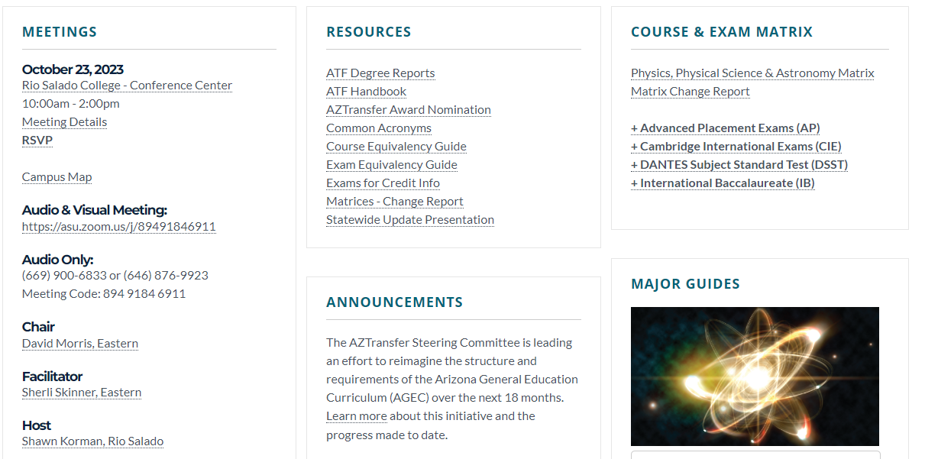
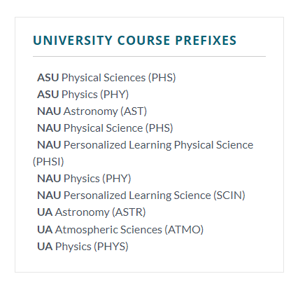
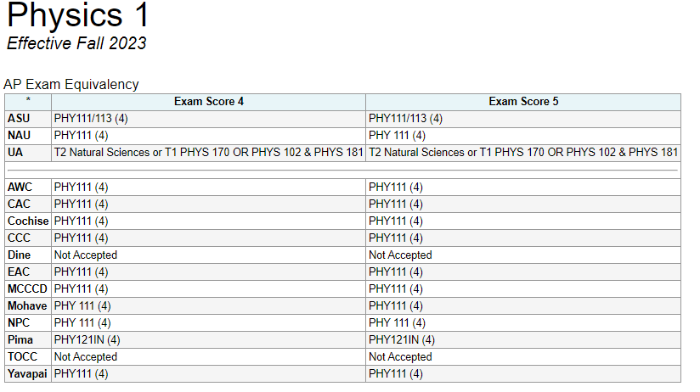
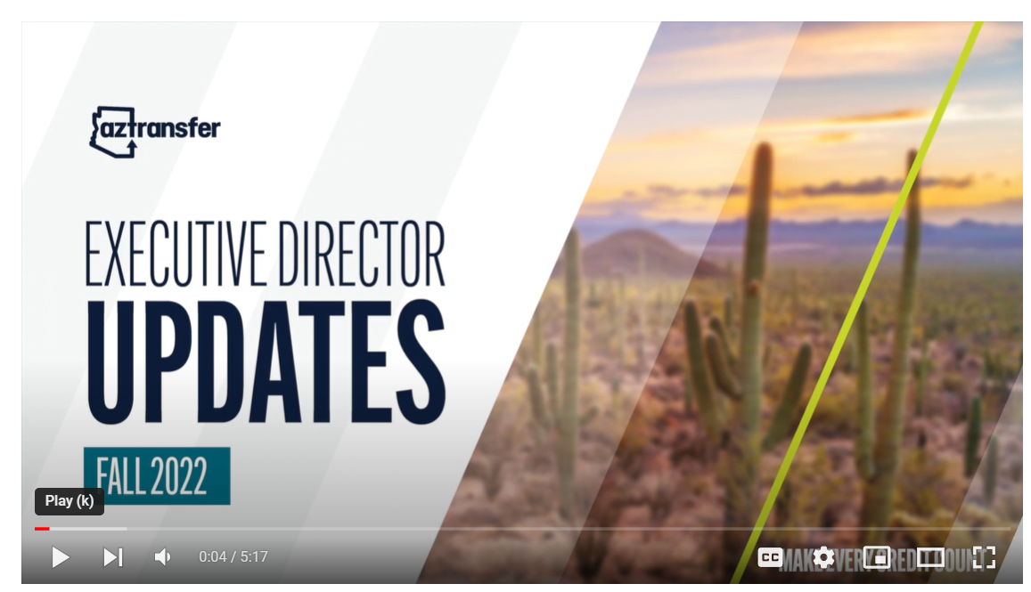
Arrive 45-60 minutes early to make sure I can get into Zoom.
Place all the important information on my desktop to have open and ready for the meeting so I’m not trying to open it as we move down the agenda!
Meeting Set-up

Slide 7


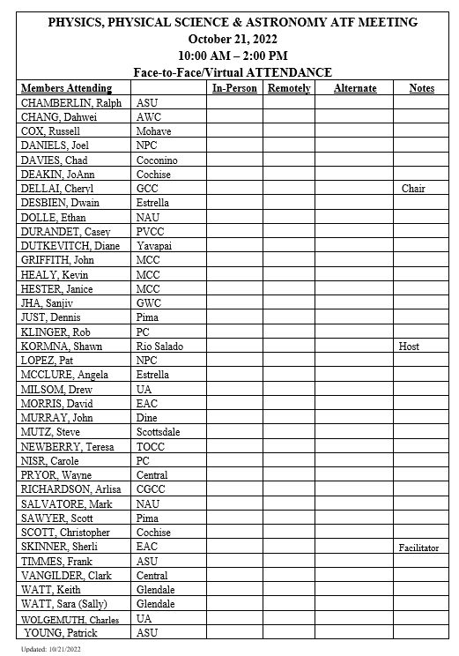
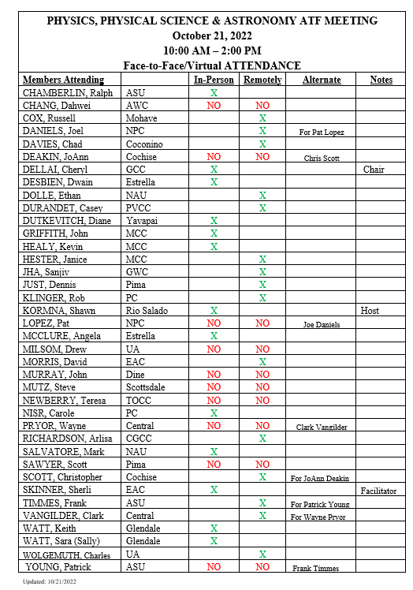
ATTENDANCE BEFORE & AFTER MEETING
DURING THE MEETING
Chair and/or myself will place an attendance list for members to check/sign that they are in attendance
Verbalize the list by calling out each of the members listed to make sure they are in attendance both face-to-face and virtually

Slide 8
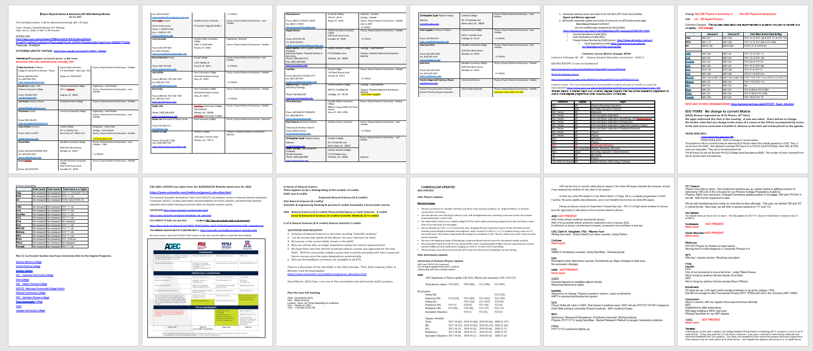
After the meeting
Notes from the Notetaker:
Give them my email address to send me the notes
Take a picture of what notes have been taken
Follow-up to make sure notes are sent before the 14 days

Slide 9
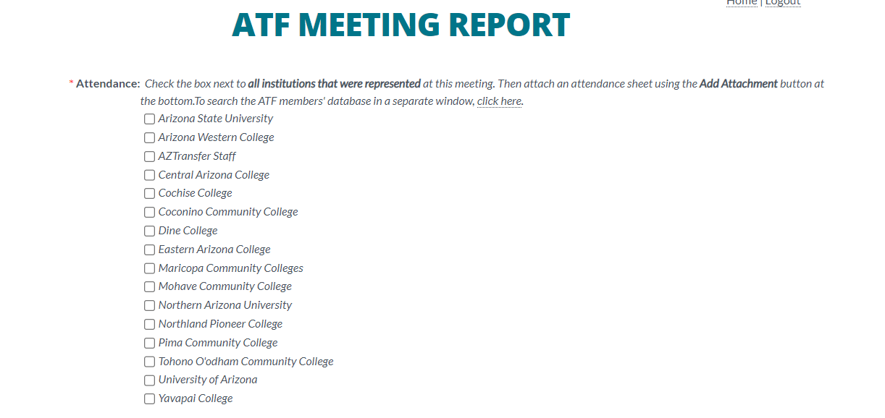

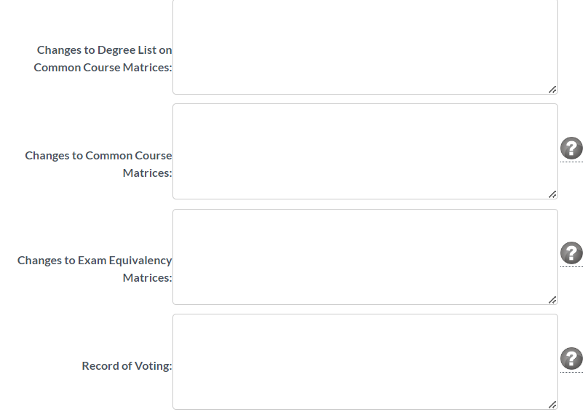
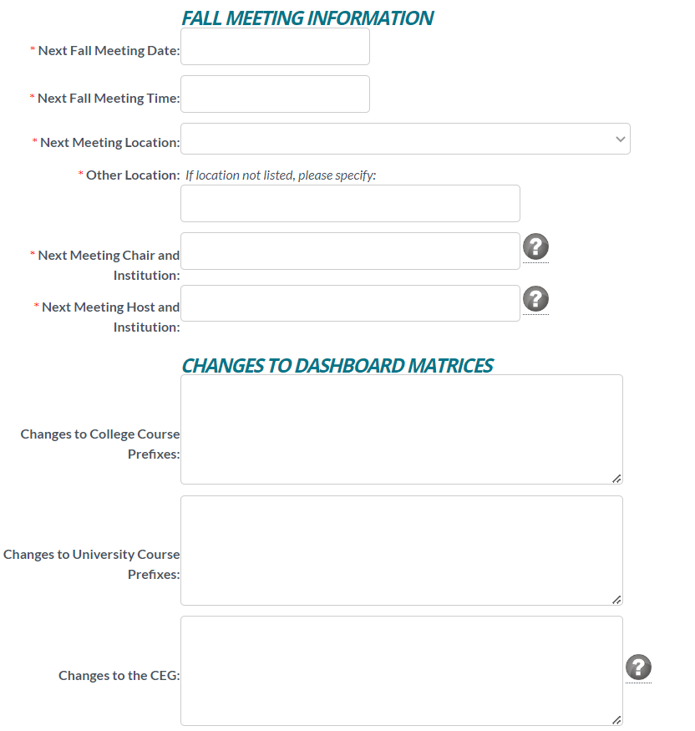
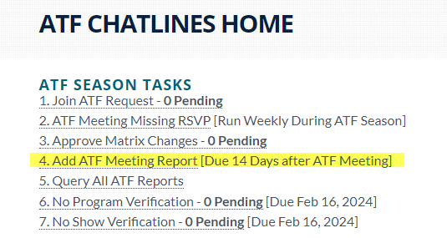
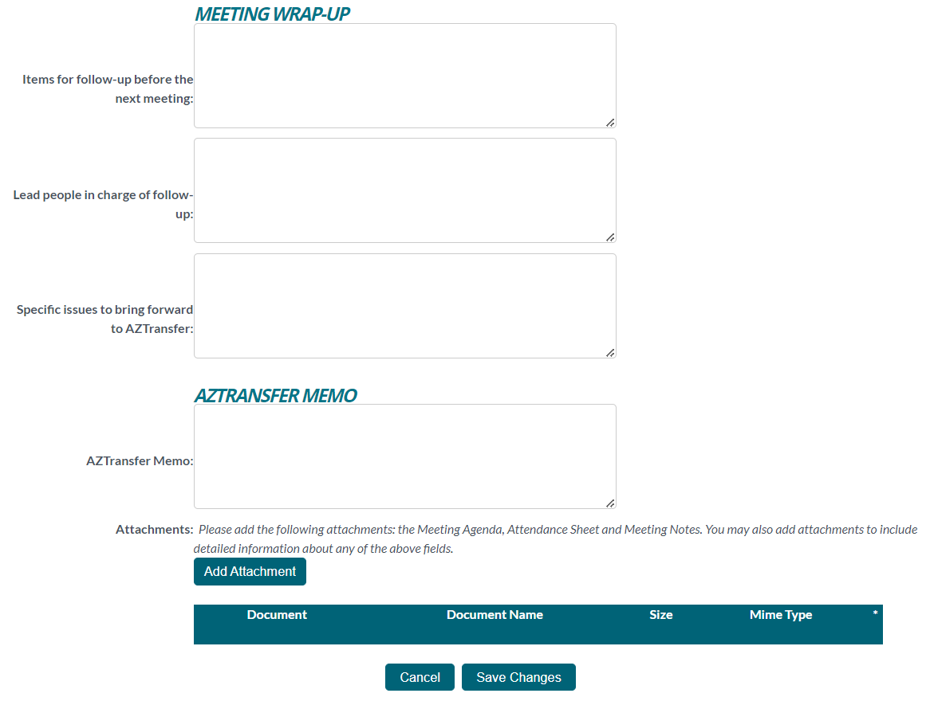
When the meeting is at the end of the agenda I will go in and start the ATF meeting report while all the information is fresh on my brain!
Then I’m able to make the necessary changes to the matrix, if reported, and report any prefix changes.
Once I receive all the documentation, I upload the:
Meeting Agenda
Attendance Record
Notes

Slide 10


Thank you!
Questions?

