Slide 1
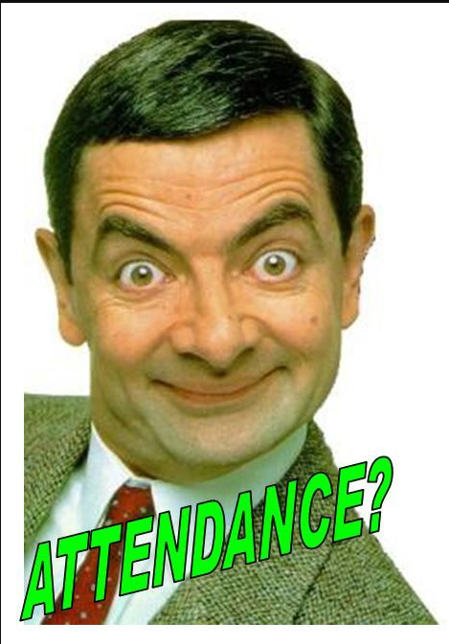

ATF Attendance
Alecia Mooney

Slide 2
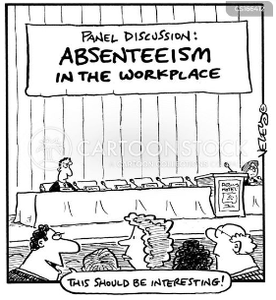

Slide 3


Slide 4
Before ATF Season
May/June – Email Associate Deans/Chairs – any changes to membership?
July – Make membership changes in the ATF Chatlines/database
August – Send a welcome email out to all ATF Members with active link to AZ Transfer ATF meeting dashboards. AZ Transfer sends emails out.

Slide 5
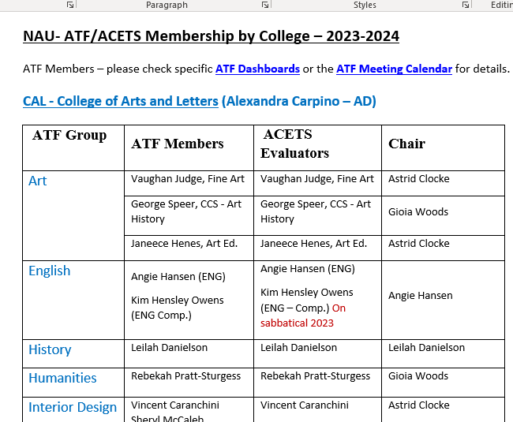

Slide 6
During ATF Season – Always Checking In…
September – ATF Training
White Board – weekly ATF meetings and membership
ATF Chatlines – Visit the RSVP by Institution link often and print out the report. Anyone missing – send an email.
Weekly emails - to all members wishing them a successful meeting on Friday with active link to dashboard or Zoom link.

Slide 7
After ATF Season
Nov./Dec. – Optional follow-up feedback email – anything I need to be award of – changes, etc.?
Jan./Feb. – Attendance report from AZTransfer is delivered. Provost/Vice Provost sends out an email to faculty thanking them for their attendance and representing the university.

Slide 8


