Slide 1
ATF Season:
Building Efficiency at Pima Community College
Guadalupe Serrano-Villela, Curriculum Quality Improvement (CQI)

Slide 2
AGENDA
What will we learn today:
3 Steps for Success
Prior to ATF Season
During ATF Season
After ATF Season
Key Takeaways

Slide 3
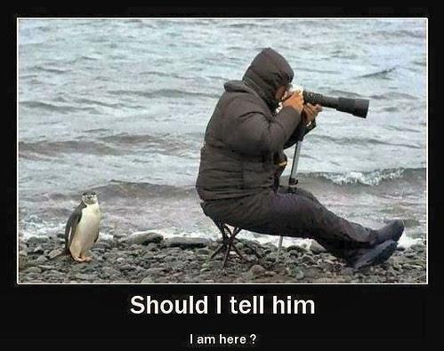
“Fail to plan; plan to Fail.”

Slide 4
3 Steps for Success!
PLAN
Each ATF season starts out with a plan for communication, entering information and facilitating the events.
1
PERFORM
Cross-training is key! Curriculum Quality Improvement (CQI) cross-trains everyone in the office to identify what is needed before, during and after ATF season.
2
EVALUATE
Every year an after action is conducted to identify what worked, what didn’t work and ways to improve. Continuous improvement = Continuous Success!
3

Slide 5
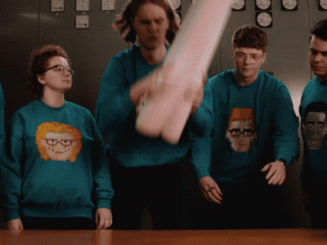
Coordinating the ATF season at PCC…

Slide 6
Before ATF Season:
ATF Chatlines
No program verification
Build ATF information into google survey
Create google folder with all ATF information
Communication is KEY!
January: Identify faculty lead and alternates
April: All ATF RSVPs are due
June: CQI blocks calendar for ATF’s assigned to PCC
August: All ATF google surveys are due
Continuous Work:
CQI office monitors google surveys
CQI office updates any information via the chatlines and draft catalog
Update lead and alternate info, as needed

Slide 7
Why Google Surveys? It’s so much easier!!!
PCC is a google school
We have used google to track our ATF lead and alternate information
We are now using google forms to update ATF information well before the fall semester for our PCC faculty
We used google forms last year for our facilitator lead ATFs and received major kudos!
Much of the work we do during the ATF can be done ahead of time, making the season that much more efficient and allowing our faculty to focus on meaningful discussion.
Training opportunity for our faculty ATF leads and alternates

Slide 8
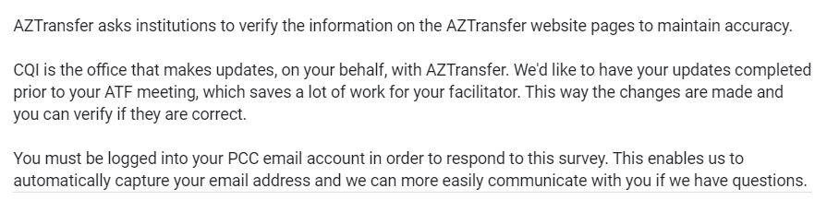
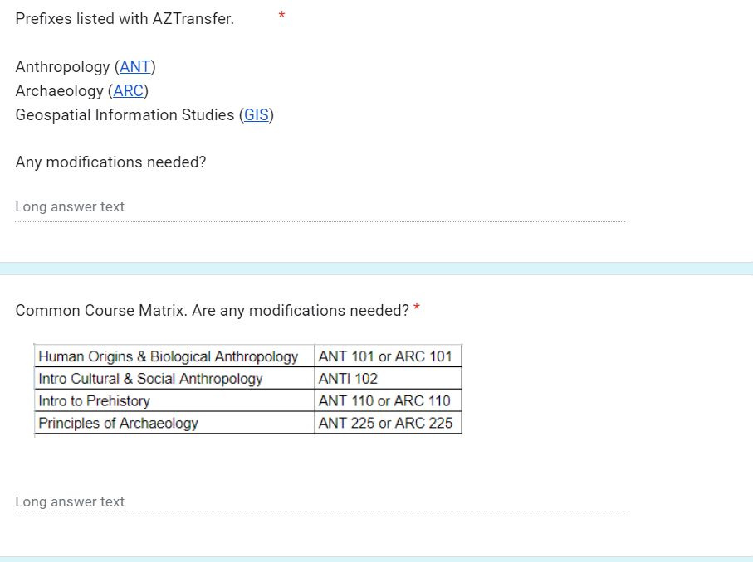
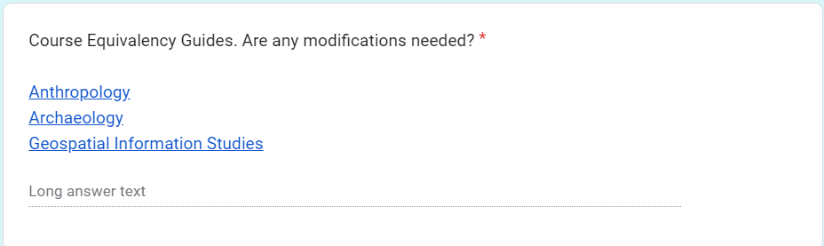
Example of what is built in the google survey: Section 1
COMMON COURSE/
PREFIXES
SPECIFIC
CEG INFO:
COURSE INFO:

Slide 9
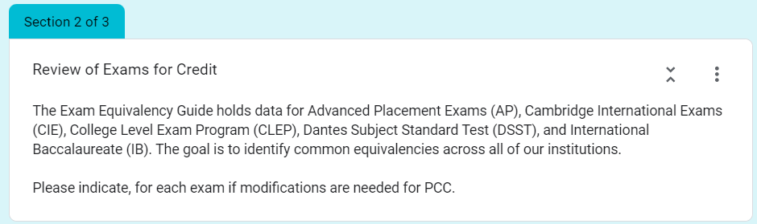
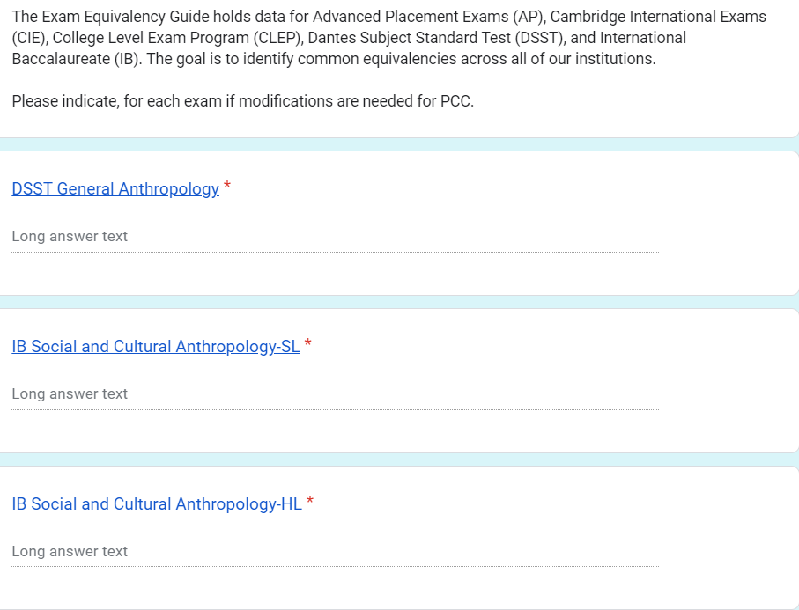
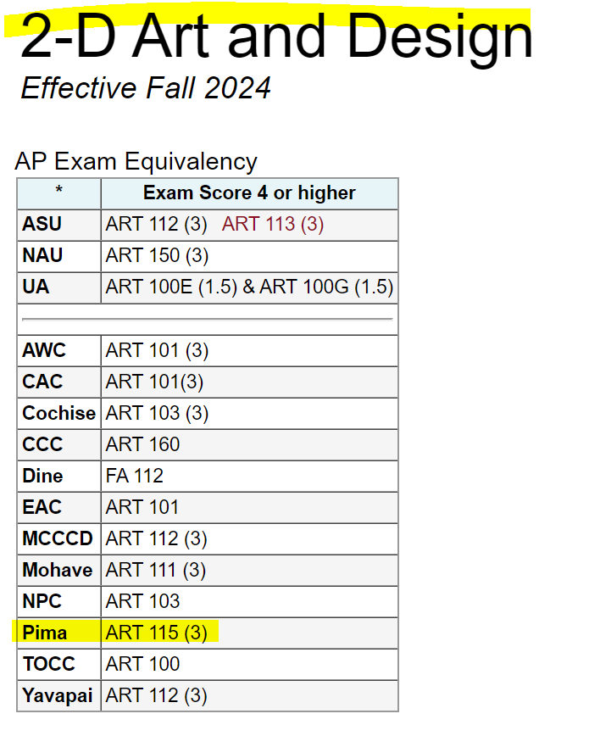
Example of what is built in the google survey: Section 2
EXAM INFO:
EXAMS:
LINK SPECIFIC EXAM INFO:

Slide 10
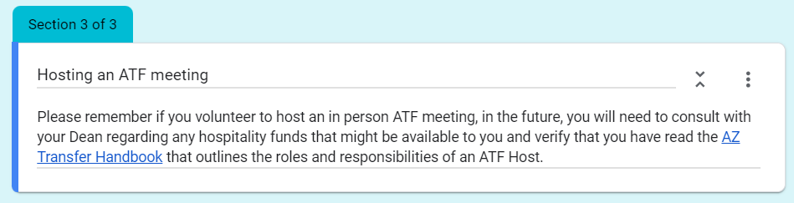
Example of what is built in the google survey: Section 3
HOST/CHAIR ATF?
DATE of NEXT ATF:
NEXT ATF:
If the answer is “no”, nothing further needed. If the answer is “yes”, approval must be given by the dean and hospitality funds secured through the Provost’s Office
We use the same date as the current ATF and bump it out by one year.

Slide 11
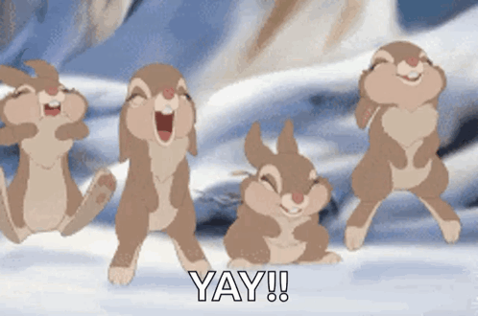
When one person out of 25 completes the survey…

Slide 12
During PCC’s ATF Season:
Communicate early and often
CQI reaches out to chair and ATF a month prior to the event
We create google surveys for those faculty and begin sending them out
Survey information is updated in the chatlines as it is received
All hands on deck!
CQI office (5 in total) attend PCC facilitated ATFs- regardless of job title
One person monitors the chat
One person takes attendance
One person takes notes
One person updates the chatlines
One person facilitates
Continuous Work:
Meeting minutes are reviewed and uploaded after each ATF meeting
Attendance is reviewed and uploaded after each meeting
All other ATF related items are reviewed and uploaded after each meeting

Slide 13
During ATF meeting - Helpful Tip!
Initiate ATF meeting report in the chatlines
  Include information such as attendance, next meeting information, pathways, CEG changes, exam equivalencies, etc.
  Verify that common course and exam matrix changes have been entered in as Proposed Matrix Changes in the Chatlines.
Submit report for review by AZTransfer staff!

Slide 14
After ATF Season:
Monitor ATF Chatlines
CQI continues to monitor the chatlines through December
We make sure our internal processes are followed
Any chatline updates in question are immediately addressed with the PCC faculty
PCC Stakeholders
Updates are given regularly and often to PCC stakeholders regarding ATF season.
This is a college wide initiative and is approached as such
Continuous Improvement:
After action is all about ways to improve and to highlight what worked and didn’t work
This is a time for constructive reflection
ALL ideas and feedback are welcome during these sessions.

Slide 15
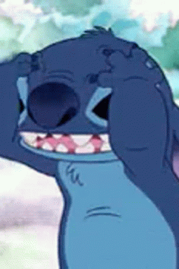
EPIC FAILURE!
Is always an opportunity for improvement :)
When you have spent countless hours trying to make things easier for ATF members but they ignore your emails and don’t fill out the surveys prior to the meeting…
Communication with ATF early and often!
Follow up with specific faculty who do not fill out the survey
ATF Faculty have praised the efficiency the survey has provided which allows for more meaningful discussions at the ATF meetings.
KEY TAKEAWAY: Majority of the facilitator’s work can be done prior to the ATF meeting.

Slide 16
What did we cover today?
Identified the 3 Steps for Success
How to be more efficient in our work before, during and after ATF season
Communication is key!

Slide 17
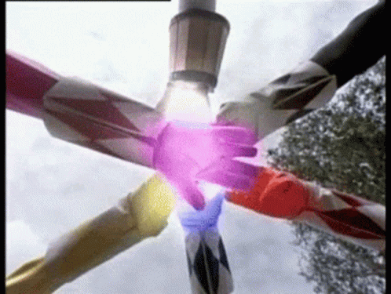
Teamwork makes the Dreamwork!
THANK YOU!!!

